Slide 1
Manipulating Table Data
Insert Data
Modify and Delete Data

Slide 2

The INSERT Statement
Target table
Target columns
Values to be inserted into the target columns

Slide 3
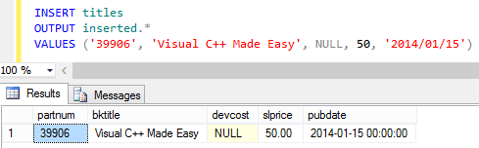
The OUTPUT Clause
Used with the INSERT statement
Values inserted into corresponding columns
The OUTPUT keyword
The OUTPUT clause displays the results of the INSERT statement

Slide 4
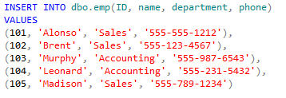
Table Value Constructors
Used with the INSERT INTO statement
Values to insert in corresponding columns

Slide 5

The UPDATE Statement
The UPDATE statement
Column to be updated
The SET keyword
Condition

Slide 6

The DELETE Statement
The DELETE keyword
Search condition

Slide 7
The TRUNCATE TABLE Statement
The TRUNCATE keyword
Targeted table

Slide 8
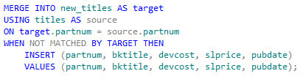
The MERGE Statement
The MERGE keyword
The INSERT keyword

Slide 9
Reflective Questions
What are the benefits of manipulating table data?
Why should you delete unused records or tables in a database at regular intervals?

